Slide 1
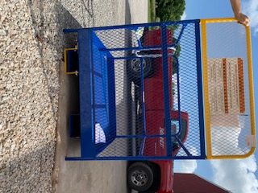
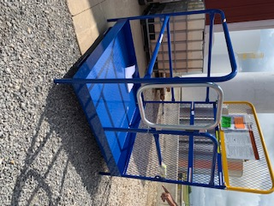
Training – Work Platform Safety Instructions
Before Use
Forklift must have a minimum capacity of 3,000 lbs to use the platform
Inspect tine locks, safety strap and snap hook, gates, chains, and fork pockets BEFORE using platform
  DO NOT USE if damage or excessive wear discovered
  Only use MANUFACTURER supplied replacement parts
Inspect area where will be used to identify hazards
  DO NOT use near electrified wires or other sources of electricity
  Use only on even, level surfaces
Securely connect platform to lift truck (refer to Use and Maintenance Manual for proper instruction)
  Attach safety strap to fork carriage without slack and
  Apply tine lock

Slide 2
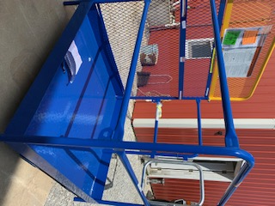
Training – Work Platform Safety Instructions
Platform occupants when in use
ALWAYS use Fall arrest equipment (harness with lanyard) that must be attached to platform anchorage point
  Only 1 person per anchorage point
Wear Hard Hat
DO NOT climb on or lean against gate, chains, or guardrails
DO NOT exceed max rated load of 1,000 lbs
Forklift operator when in use
Engage platform correctly – forks must project through all fork pockets
DO NOT drive forward or in reverse while platform occupied
DO NOT tilt mast – forks must be level
Apply parking brake BEFORE raising platform
Anchor Point

Slide 3
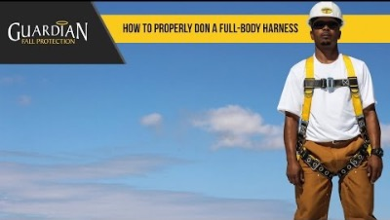
How To Properly Don A Full Body Harness - Guardian Fall Protection
Press Shift+F5 to view the slide in presenter mode. Then click the video to view

Slide 4

Training – Fall Protection Harness/Lanyard Inspection & Use
Webbing – check for cuts, tears, holes, abrasions, overspray, chemical damage and UV damage
Grasp webbing with both hands and bend into a for better view
Stitch pattern – check for completeness – if stitching is missing or coming undone remove harness from service
D – rings, buckles, grommets – inspect D-ring, metal keepers, buckles, adjustments for deformity, corrosion, function. They must pivot freely.
Impact indicators – if stitches are popped, that indicates impact and/or a fall. The harness should be immediately discarded.
Labels – if tags/labels are missing or not legible, the harness must be removed from service

Slide 5
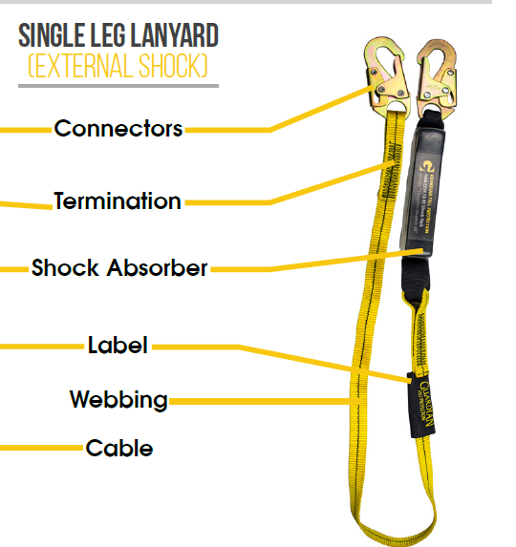
Training – Fall Protection Harness/Lanyard Inspection & Use
Connectors – inspect for deformity, corrosion, function, pitting. They must self close and lock.
Webbing – check for cuts, tears, holes, abrasions, overspray, chemical damage and UV damage. Grasp webbing with both hands and bend into a for better view
Shock pack – plastic/shrink tube must remain intact, do not cut or remove. If stitches are popped or impact indicator shows signs of deployment, the lanyard should be immediately discarded.
Labels – if tags/labels are missing or not legible, the harness must be removed from service

