Slide 1
BRANDT Railcar SOP’s

Slide 2
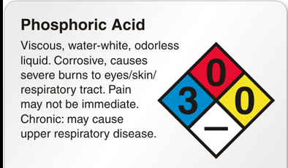
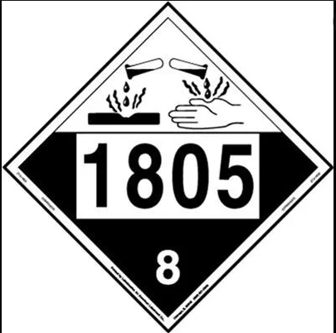
Phosphoric Acid
Acid Hazards, PPE, Safety Measures
PPE required for acid transfer operations on railcars
Impervious Gloves
Chemical Goggles
Face Shield
Acid Apron
Fall Protection
Acid hazards
Severe skin burn and eye damage
Harmful if swallowed
May cause respiratory irritation
Safety Measures
Wear all required PPE
Do not breathe fume, mist, vapor, or spray or eat, drink, or smoke when using this product
Wash hand and forearms thoroughly after handling
Use outdoors in well ventilated area

Slide 3
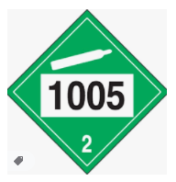
Anhydrous Ammonia
Anhydrous Hazards, PPE, Safety Measures
PPE required for anhydrous operations on railcars
Ammonia Gloves
Non vented ammonia Goggles
Face Shield, work clothing protection
Fall Protection
Acid hazards
Severe skin burn and eye damage
Harmful if swallowed
May cause respiratory irritation
Safety Measures
Wear all required PPE
Do not breathe fume, mist, vapor, or spray or eat, drink, or smoke when using this product
Wash hand and forearms thoroughly after handling
Use outdoors in well ventilated area

Slide 4
Potash
Potash Hazards, PPE, Safety Measures
PPE required for potash operations on railcars
Safety glasses, tight fitting goggles in areas of high dust concentration
Gloves, long sleeve pants and shirts as applicable
Dust mask in areas of high dust concentration
Potash hazards
Causes skin & eye irritation
Harmful if swallowed
May cause respiratory irritation
Safety Measures
Wear all required PPE
Launder clothing after use

Slide 5
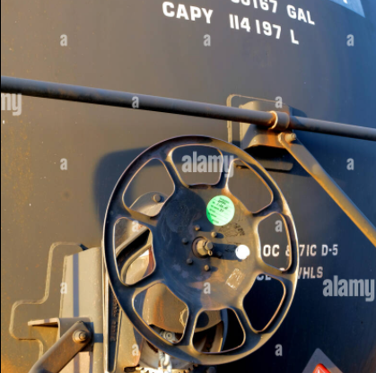
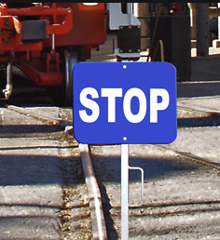
Phosphoric Acid/Anhydrous Tank Car Spotting Procedures
Railcar Spotting Procedures
Position railcar properly at the unloading riser
Ensure brakes are fully set – check the brake hand wheel at the end of the tank car to ensure full engaged
If multiple cars coupled together, sufficient handbrakes must be set
Minimum handbrake applied is 1
Additional handbrake for every 10 cars
1-9 cars = 1 handbrake, 10-19 cars = 2 handbrakes, 20-29 cars = 3 handbrakes, 30 – 39 cars = 4 handbrakes
Ensure chock blocks are placed in front and behind at least one wheel of the tank car
Place the blue stop sign in between the rails, at least one car length away from the car being worked on
Language must face the direction of any open end to the work being performed – Multiple open direction of exposure = multiple signs needed
Derail must be set to derailing position, following manufacturer instructions
2 derails must be set for Waverly, one in each direction

Slide 6
Potash Rail Car Spotting procedures
Ensure railway clear of all obstacles
Both switches in proper operating condition & clear of snow and debris
Snow and debris should be removed 10 feet before & 10 feet after the switch rod
Correct sign posted to designate which track to spot cars on
Orange cone located at least 30 feet short of where cars should be spotted
Proper amount of handbrakes set prior to releasing air
Minimum handbrake applied is 1
Additional handbrake for every 10 cars
1-9 cars = 1 handbrake, 10-19 cars = 2 handbrakes, 20-29 cars = 3 handbrakes, 30 – 39 cars = 4 handbrakes
Check radios for proper working condition

Slide 7
Phosphoric Acid/Anhydrous Tank Car Documentation Review
Railcar documentation
Should have bill of lading, shipping papers, and railcar release forms
Bill of Lading Review
Shipping name – verify acid or anhydrous is in railcar
Railcar – verify same as identified on bill of lading
Verify BRANDT is consignee

Slide 8
Tank Car Loading/Unloading
Drag mouse over video, push play at bottom of video to play
Drag mouse over video, push play at bottom of video to play
Video 1: Anhydrous Ammonia Hands-On Railcars
Video 2: Tank Car Loading & Unloading
Click on “Video 1” and “Video 2” to watch videos
Fall protection, harness and lanyard, must be worn when on top of rail cars, utilizing crash bar as tie off point.
SOP’s are available at all respective railcar sites. Before unloading, review site specific SOP’s as needed

Slide 9
Midstate Unloading
Check car number with car list before unloading
DO NOT unload if not on list
Radio communication devices must be available & working
Cars shall only be pushed when another employee with a radio is monitoring the lead car
Loader operator shall not move cars until clear orders are given
Cars hooked to loader shall only have handbrakes released when:
Operator is in loading cab
Or parking brake is applied to loader

Slide 10
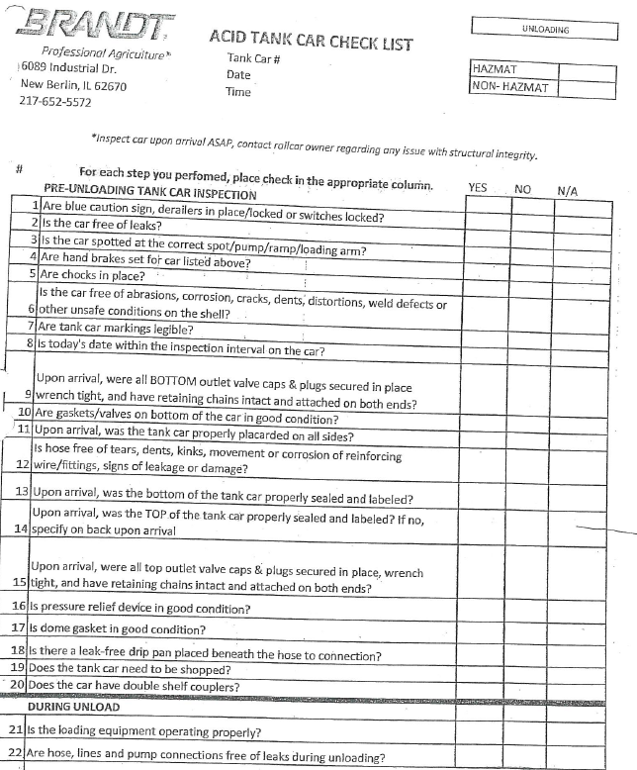
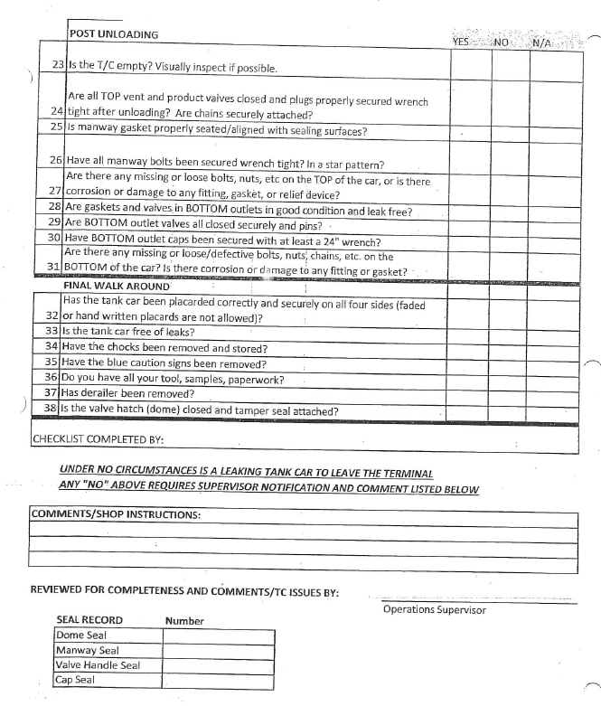
Tank Car (Curran, Waverly) Inspection Check List
All inspections need to be documented on the BRANDT Tank Car Check list and kept on file for each rail car
There is an acid check list (Curran) and an ammonia check list (Waverly) – ensure utilizing correct form

Slide 11
Midstate Inspection
Midstate will conduct visual inspection of cars an note any discrepancies on the railcar release form

Slide 12
Releasing Cars
Midstate
Release will be done online by Plant Manager
Any deficiencies with cars will be noted on release form
Waverly/Curran
Release will be done online
Refer to site specific SOP’s for detailed instructions
Refer to site specific SOP’s for detailed instructions

Slide 13
Security
Visitors
Sign in and out of log book
Entrances to buildings should be closed or locked if not attended by plant personnel
Transportation
Railcars/Vehicles will be inspected prior to loading/unloading hazardous material
Personnel
Background checks, pre-employment drug screens for employees
Must not have access to hazardous materials without consent and presence of qualified employee
NH3 tanks should be checked for suspicious items attached to tanks, pumps, etc.
Comply with proper packaging, compatibility, & segregation regulations while shipping, storing, or handling any hazardous material
Any significant/imminent danger or suspicious activity posing danger to the company, employees, other persons, facilities, or equipment should be immediately reported to local authorities and/or EHS, Cortney Graham.

