Slide 1
Environmental, Health, and Safety Annual Training Feb 2022
Accident Reporting/Emergencies, BB Pathogens, Fire Extinguisher, Fall Protection/Platform Use, Forklift/Scissor, Boom Lift

Slide 2
Accident Reporting/Emergencies

Slide 3
Emergency Procedures
Ammonia Leak/Spill – a release of 100lbs or more requires additional notifications
Refer to emergency response cards for proper notifications
Vehicle Accident/Spill – notify authorities to receive reports as applicable
Refer to emergency response cards for proper notifications

Slide 4
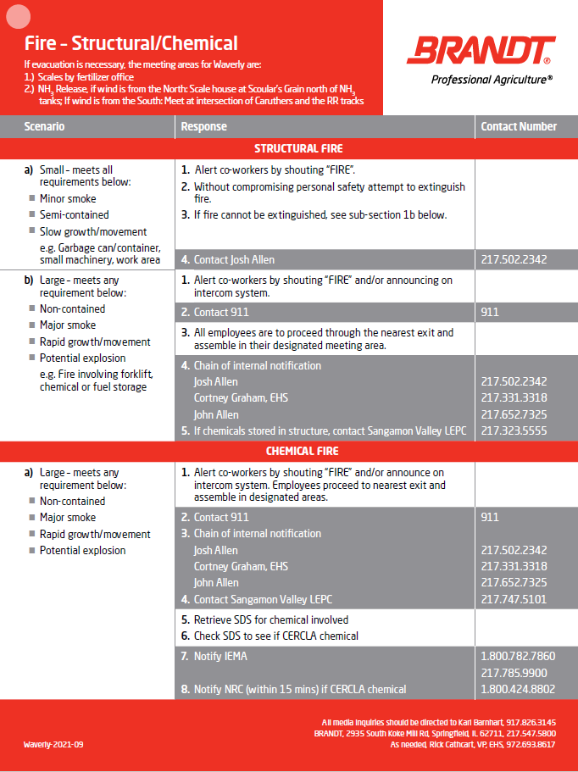
Emergency Procedures
Your site emergency procedures for the below listed emergencies can be found on Emergency response cards located in vehicles, office and throughout facility. Ensure you know the where to find these and review for evacuation areas and emergency contact information.
Fire – Follow notification procedures outlined in response cards & Evacuate the building as applicable
Utilize fire extinguishers only if have been properly trained and fire is small enough to extinguish without compromising personal safety
First Aid Injury/Illness - Contact Supervisor, Dial 911 for emergencies, Report to EHS, Cortney Graham
Refer to emergency response cards for proper notifications
Severe Weather - Upon notification, proceed to shelter area

Slide 5
First Aid/Injury/Illness
Employees are to report near misses, incidents, accidents to management immediately after they become aware of such. Upon notification, assess to determine proper medical treatment is provided.
Emergency
On-site medical treatment, non-emergency
may provide basic first aid up to the provided level of training
Non-emergency, treatment beyond basic first aid
provide off-site medical treatment at the nearest medical facility. Must have Drug & Alcohol testing when sent for off site medical treatment
The supervisor, or designee shall provide transportation as needed.
9-1-1

Slide 6
Bloodborne Pathogens

Slide 7
Bloodborne pathogens
What are they?
Pathogenic microorganisms that are present in human blood and can cause disease to humans
Exposure Potential
Caring for an ill or injured person who is experiencing bleeding or loss of another bodily fluid
Examples include HIV, Hepatitis B, and Hepatitis C
During a clean-up incident following an injury or illness in which bleeding or loss of another bodily fluid occurred

Slide 8
Why are we concerned?
Accidental contact with contaminated blood can infect a person who is providing first aid or who is cleaning up a spill of blood or other bodily fluid.
For an infection one of the following must occur:
The infected blood (or other fluid) contacts broken skin (a cut, rash, abrasion, etc.)
The infected blood (or other fluid) contacts a mucus membrane (eye, nose, mouth, etc.)
Either event is called an Exposure Incident

Slide 9
BRANDT occupational exposure
Job Function | Job Tasks
Janitorial | Decontamination of contaminated surfaces and/or objects, Handling of regulated wastes, Housekeeping in areas where contamination may occur (i.e. restrooms)
Other Employees* | Emergency First Aid Providers
* Other employees, as a collateral duty to a primary work assignment, may have an occupational exposure when responding to injuries resulting from workplace incidents for the purpose of rendering first aid.
These incidents of occupational exposure must be reported to the employee’s supervisor as soon as possible for appropriate medical follow up. Employees in this category will be offered post-exposure hepatitis B vaccinations

Slide 10
Universal precautions
Treat all blood and other bodily fluids as if they are known to be infected
Always wear required level of PPE when responding
One does not know if an individual is infected with a Bloodborne pathogen
Remove PPE Carefully and discard
Wash hands with soap and water

Slide 11
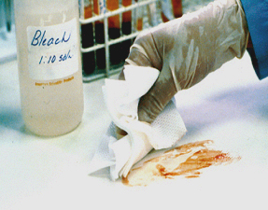
Procedure
Contaminated areas should be effectively barricaded until properly decontaminated
A solution of ten parts water to one part chlorine bleach (e.g., Clorox) should be used and made up fresh
large quantities of spent or used absorbing first aid supply, contaminated by blood or OPIM, shall be contained, labeled, and sent in a plastic bag with the injured employee to the medical facility
If further medical procedures are not required and nominal quantities of saturated absorbents (i.e., dressings, gauze) or non-absorbing materials are present, decontaminate them and dispose as normal trash

Slide 12
Fire Extinguishers

Slide 13
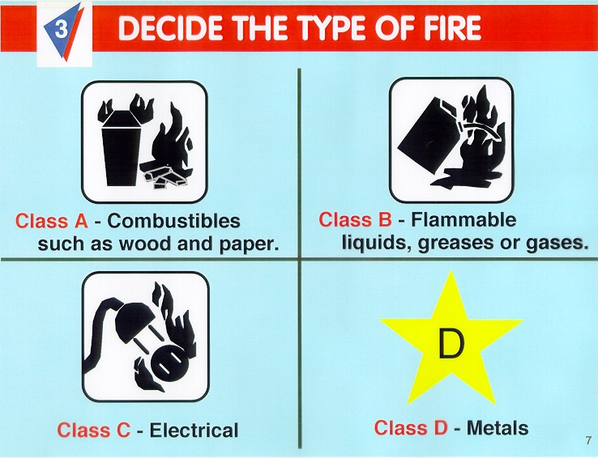
Fire Extinguishers
Notes:
There are four different types of classes when it comes to the substance that may cause a fire.
Class A- Combustibles such as wood and paper
Class B- Flammable liquids, greases or gases.
Class C- Electrical
Class D- Metals

Slide 14
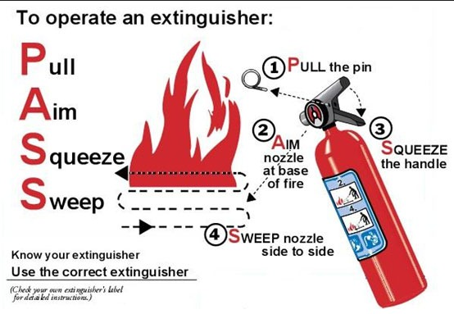
Fire Extinguishers
IF it is a smaller fire (normal trash can size), locate a fire extinguisher and employ the PASS method up to your level of training. DO NOT ATTEMPT if you are unsure or if fire is larger than normal trash can size.

Slide 15
Fall Protection/Ladder Safety

Slide 16
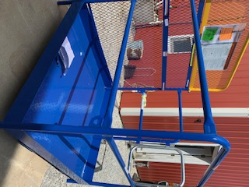
Work Platform Safety Instructions
Platform occupants when in use
ALWAYS use Fall arrest equipment (harness with lanyard) that must be attached to platform anchorage point
Only 1 person per anchorage point
Wear Hard Hat
DO NOT climb on or lean against gate, chains, or guardrails
DO NOT exceed max rated load of 1,000 lbs
Forklift operator when in use
Engage platform correctly – forks must project through all fork pockets
DO NOT drive forward or in reverse while platform occupied
DO NOT tilt mast – forks must be level
Apply parking brake BEFORE raising platform
Anchor Point

Slide 17
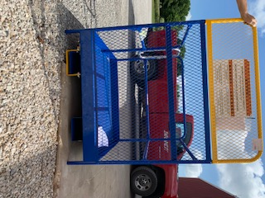
Work Platform Safety Instructions
Before Use
Forklift must have a minimum capacity of 3,000 lbs to use the platform
Inspect tine locks, safety strap and snap hook, gates, chains, and fork pockets BEFORE using platform
DO NOT USE if damage or excessive wear discovered
Only use MANUFACTURER supplied replacement parts
Inspect area where will be used to identify hazards
DO NOT use near electrified wires or other sources of electricity
Use only on even, level surfaces
Securely connect platform to lift truck (refer to Use and Maintenance Manual for proper instruction)
Attach safety strap to fork carriage without slack and
Apply tine lock

Slide 18
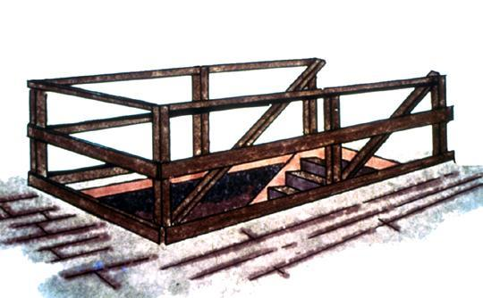
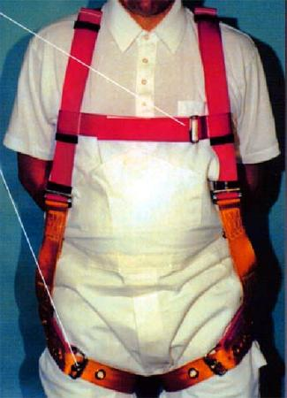
Fall Protection Options
Guardrails
Personal Fall
Arrest System
(PFAS)
Notes:
Reference 1926.501(b)(1)
General rule: If an employee can fall six feet or more onto a lower level, fall protection must be provided.
What type of fall protection will I need?
In most cases, a guardrail system, a safety net system, or a personal fall arrest system must be used. In some cases fences, barricades, covers, equipment guards or a controlled access zone may be used.
Employees must be protected not just from falling off a surface, but from falling through holes and from having objects fall on them from above.

Slide 19
Fall Protection – Personal Fall Arrest
When working from a elevated work platform that is 4ft or more above the next level, personal fall arrest system (full body harness and appropriate lanyard) must be used and attached to appropriate anchor points.
They are also required when working from the forklift work platforms, the rail platforms, and a scissor or boom lift.
If you fall the harness/lanyard must be turned into the for destruction
100% Fall Protection is required when working 4 feet or above. Personal fall arrest systems supplement the engineering controls and work practices designed to protect our employees.

Slide 20
How To Properly Don A Full Body Harness - Guardian Fall Protection Press Shift+F5 to view the slide in presenter mode. Then click the video to view

Slide 21
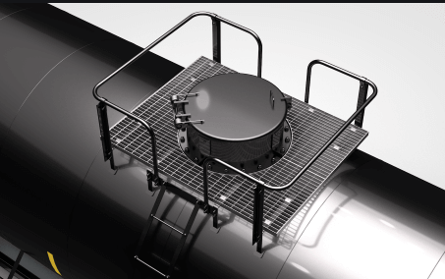
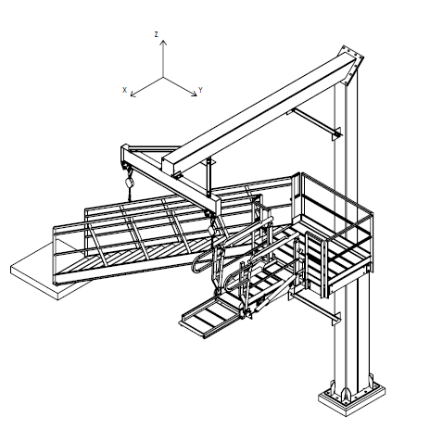
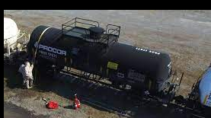
When Fall Protection is needed at BRANDT
100% Fall Protection – 100% of the time
Waverly Rail Platform (once installed)
Must utilize a full body harness with lanyard and attach to the retractable reel that is attached to the trolley beam
Maximum two people tied off at one time
Rail Cars (interim measure)
Must utilize a full body harness with lanyard and attach to the crash bar as a tie off point
Work Platforms
Must utilize harness with lanyard that must be attached to platform anchorage point
Only 1 person per anchorage point

Slide 22
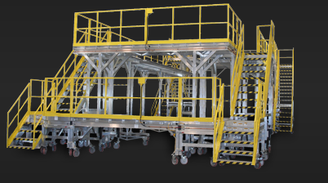
100% Fall Protection – 100% of the time
Handrails, midrails and toeboards provide fall protection from normal walking and working surfaces such as walkways, ramps, open sides and edges and holes.

Slide 23
Ladder Safety
Don’t use defective ladders and don’t try to repair
Tag out of service and throw away
Notes:
Slide Show Notes
When you uncover a safety problem with a ladder during an inspection, don’t use it. Instead, remove it from service and tag it to make sure nobody else uses it. For example, you could write “DO NOT USE” in big bold letters on a tag and attach it to the ladder where it can be easily seen.
Don’t try to repair ladders yourself. Just report the problem to maintenance and let them handle it from there. They’ll fix the ladder if they can, or it’ll be replaced with a new ladder.
Remember, never take chances with a defective or damaged ladder. Your life could depend on a mistake like that.
Do you know the proper procedures for dealing with defective ladders? You should.
Review your rules for reporting defective ladders and removing them from service.

Slide 24
LADDER SETUP
Place ladder on a clean slip free level surface.
Extend the ladder 3 feet above the top support, if used to access roof or other elevated surface. (trenches included)
4 ft.
Place the ladder base ¼ the height of the ladder from the wall when using a straight ladder. (1 ft away from the surface for every 4 feet).

Slide 25
Forklifts/Boom Lift/Scissor Lift

Slide 26
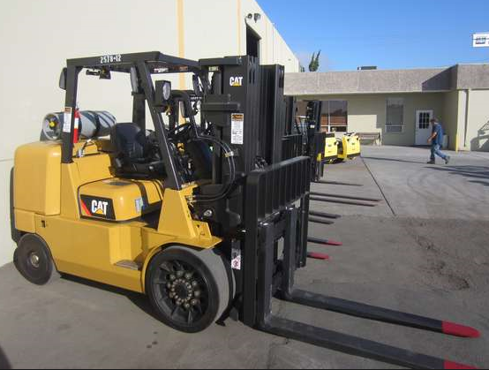
Powered Industrial Vehicles - Forklifts
Must be trained and certified in the proper operation and maintenance prior to use, every three years, and after an incident/accident.
Watch the training video on the BRANDT website and perform the driving test with your supervisor according to the checklist on the website. Have supervisor sign off on the driving checklist and keep in training files.

Slide 27
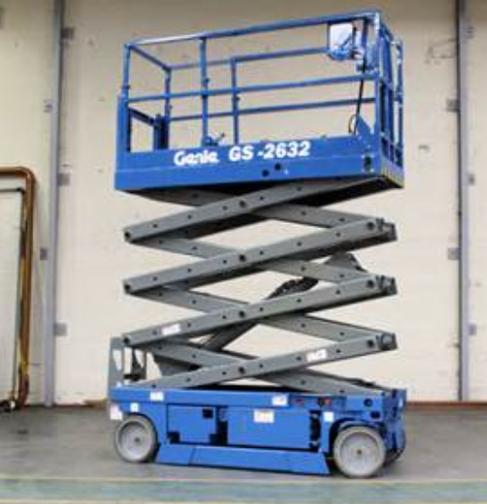
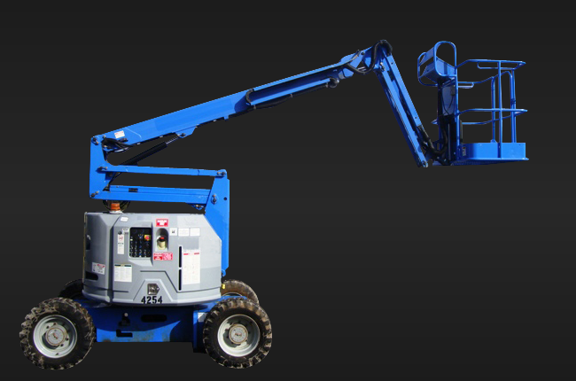
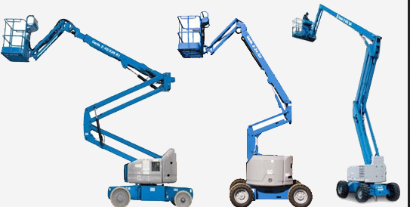
Scissor and Boom Lifts
You must receive training on the proper use and maintenance prior to using the lifts. Contact EHS as needed.

Slide 28
WOODWORKING MACHINERY
What safety procedures should you follow when using woodworking machines?
Always wear safety glasses or goggles, dust masks when required
Wear hearing protection that is suitable for the level and frequency of the noise you are exposed to in the woodworking area. If you have trouble hearing someone speak from three feet away, the noise level from the machine is too high.
Make sure the guard is in position, is in good working condition, and guards the machine adequately before operating any equipment or machine. Check and adjust all other safety devices.
What should you avoid when working with woodworking machines?
Do not wear loose clothing, work gloves, neckties, rings, bracelets or other jewelry that can become entangled with moving parts.
Do not remove sawdust or cuttings from the cutting head by hand while a machine is running. Use a stick or brush when the machine has stopped moving.
Do not leave a machine until the power off is turned off and the machine comes to a complete stop.
Do not try to free a stalled blade before turning the power off.
Ensure that all cutting tools and blades are clean, sharp, and in good working order so that they will cut freely, not forced.
Turn the power off and unplug the power cord (or lock out the power source) before inspecting, changing, cleaning, adjusting or repairing a blade or a machine.
Clamp down and secure all work pieces when drilling or milling.
Use good lighting so that the work piece, cutting blades, and machine controls can be seen clearly. Position or shade lighting sources so they do not shine in the operator's eyes or cause any glare and reflections.

