Slide 1
Environmental, Health, and Safety Annual Training Feb 2022
Lockout Tag Out, Confined Space, HAZCOM, Electrical Safety

Slide 2
Lock Out Tag Out

Slide 3
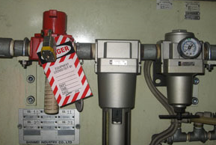
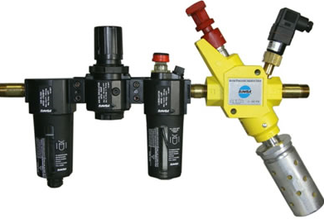
Control of Hazardous Energy – Lockout/Tagout
Three different programs that involve locking and tagging out energy hazards, they include:
Facility Energy Isolation
General Electrical Safety
Vehicle Energy Isolation
All three include qualified versus non-qualified staff training requirements.
def. Placement of a locking mechanism and identifying tags on an energy source.
Hazardous energy can be classified as:
Electrical
Hydraulic
Pneumatic
Mechanical
Chemical
Thermal

Slide 4
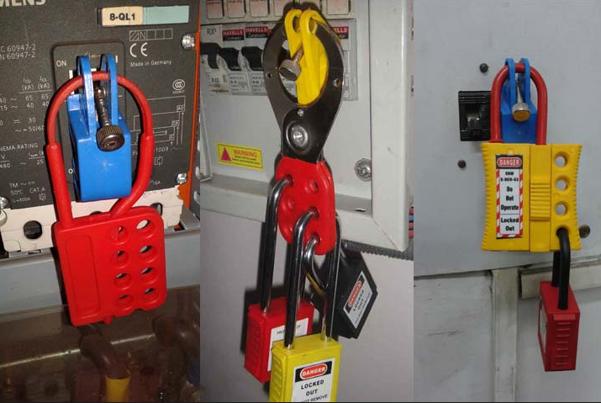
Facility/Equipment Energy Isolation - Lockout/Tagout
Typical operations that require facility lockout/tagout for the control of stored hazardous energy:
Installation of new, relocation, repair, or modification of machines or equipment
Cleaning/repairing tanks
WARNING:
The inadvertent start-up of powered equipment while being serviced can result in serious injury or loss of life.
Do not touch or operate any machine, console, or other equipment which has a red lock and/or a red "DO NOT OPERATE" tag attached to it.

Slide 5
General Electrical Safety – Lockout/Tagout
Applies to work, inspection and testing activities on electrical equipment with exposed live parts.
Only qualified employees can engage in work, inspection and testing on electrical equipment with exposed live parts.
Otherwise must be locked and tagged out of service and energy controlled.
Insulated tool

Slide 6
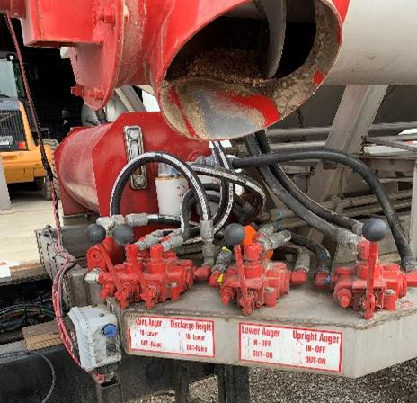
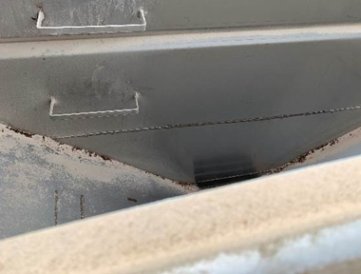
Vehicle Lock out Tag Out
Ensure all systems at area of repair are powered down and stored energy released.
Hydraulic, Pnuematic
Mechanical, Electric
Attempt to operate controls to verify energy has been shut down.
The keys to the vehicle MUST remain in possession of the person doing the work.
Any other hazardous energy
Red tag must be placed on the steering wheel indicating it is being serviced and not to be started
Only person completing the work, i.e placing the red tag can remove the red tag once work is complete
Once the work is complete, the person doing the work should
Clear all areas of the vehicle, inside and out
Communicate to others in the area that the vehicle will be cleared and inform them of start up
Any vehicle, applicator, tender trucks, etc that is being serviced for any reason, must be turned off before work begins.
Keys must remain in possession of one person completing the work at all times
Could be locked up somewhere with only one person having the key to obtain them

Slide 7
Confined Space

Slide 8
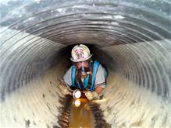
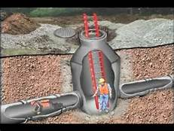
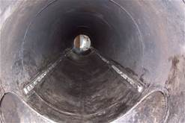
Confined Spaces
Means a space that:
is large enough and so configured that an employee can bodily enter and perform assigned work; AND
has limited or restricted means for entry and exit (i.e., tanks, vessels, silos, storage bins, hoppers, vaults and pits are spaces that have limited means of entry); AND
is not designed for continuous human occupancy.

Slide 9
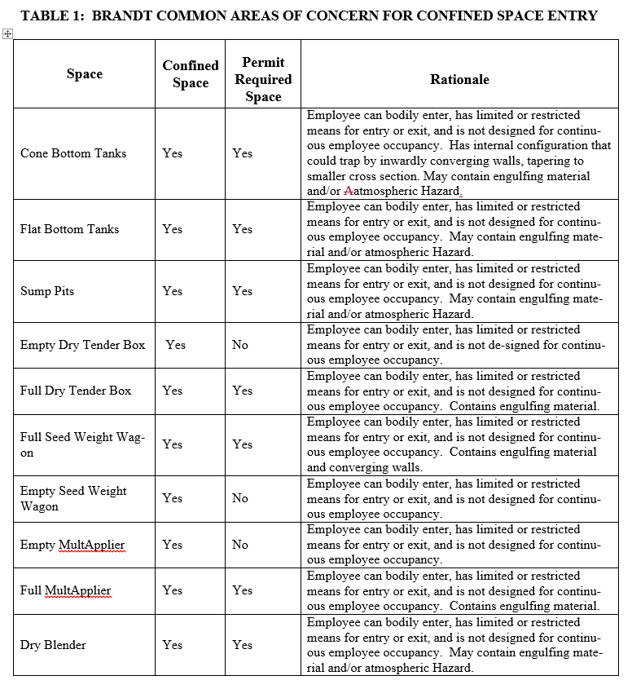
Brandt Inventory of Confined Spaces

Slide 10
Permit Required Confined Spaces
BRANDT employees MAY NOT enter the following permit required confined spaces:
Cone Bottom Tanks
Vehicles that contain engulfing material or hazardous atmosphere (i.e full seed weight wagon, full MultApplier, etc)
Equipment containing engulfing material or hazardous atmosphere (i.e blenders)
Permit Required confined spaces means a confined space that:
contains or has the potential to contain a hazardous atmosphere; AND/OR
contains a material that has the potential for engulfing an entrant; AND/OR
has an internal configuration such that an entrant could be trapped or asphyxiated by inwardly converging walls or by a floor which slopes downward and tapers to a smaller cross-section; AND/OR
contains any other recognized serious safety or health hazard.
Requires a written procedure for preparing and issuing permits for entry and for returning the permit space to service following termination of entry.

Slide 11
Alternate Procedures for permit required confined spaces
Alternate procedures can be used provided that:
The employer can demonstrate that the only hazard posed by the permit space is an actual or potential hazardous atmosphere;
The employer can demonstrate that continuous forced air ventilation alone is sufficient to maintain that permit space safe for entry;
The employer develops monitoring and inspection data that supports the conditions.
BRANDT MUST FOLLOW THE ALTERNATE PROCEDURES BELOW FOR ENTRY INTO ALL OTHER PERMIT REQUIRED CONFINED SPACES:
Atmosphere must be tested prior to entry with a calibrated four-gas monitor, which can be obtained from tool from the Curran facility.
Continuous monitoring with gas monitor is required at all times while in the tank
Must have an alternate entry permit
Space must be aired out before entry and forced air ventilation shall be used at all times while in the tank to control any atmospheric hazard.

Slide 12
Non Permit Required Confined Spaces
Empty Equipment (i.e Blender)
Empty Vehicles (dry tender box, empty seed wagon, empty MultApplier, etc)
Means a confined space that does not contain or, with respect to atmospheric hazards, have the potential to contain any hazard capable of causing death or serious physical harm.
If the permit space poses no actual or potential atmospheric hazards and if all other hazards within the space are eliminated without entry into the space, the permit space may be reclassified as a non-permit confined space for as long as the non-atmospheric hazards remain eliminated.
The energy isolation procedures must be achieved from outside the space by locking and tagging out the electrical sources, thus eliminating the non-atmospheric hazard.

Slide 13
Electrical Safety

Slide 14
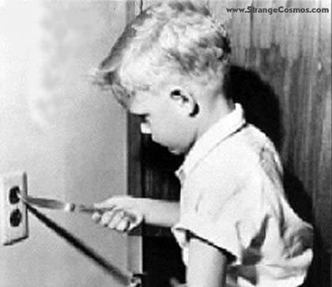
Electrical Safety
Electricity can cause extreme harm if is allowed to enter or come in contact with your body.
Treat every electrical line as a live one
ONLY QUALIFIED AND AUTHORIZED PERSONS, who have been trained in the correct procedures and PPE, are permitted to perform any type of electrical work. This includes, but is not limited to, removing protective covers, making electronic adjustments, or simply opening a cabinet where live electrical components may be present.
If you find an electrical issue such as exposed wiring, electrical panels exposed or covers missing, DO NOT ATTEMPT TO REPAIR ELECTRICAL ISSUES ON YOUR OWN.
Ensure all electrical hand tools are in good working order free of any cord damage such as frays, cuts etc.
Electrical
Extension cords are safe if used properly.
Do not run extension cords across walkways or areas of frequent traffic.
Extension cords are not meant t be used as permanent wiring.
Make sure extension cords are in good working order free of any cuts, frays etc.

Slide 15
PPE

Slide 16
PPE – Eye and Face Protection
Safety glasses – required in all industrial areas when hazards may be present.
Safety goggles – when working with potential splash hazards (chemicals, dusts, fumes); when handling ammonia equipment or hoses
Safety spoggles – in dusty atmospheres
Face Shields – may be worn over glasses or goggles when splash hazards are present or transferring chemicals.

Slide 17
HAZCOM

Slide 18
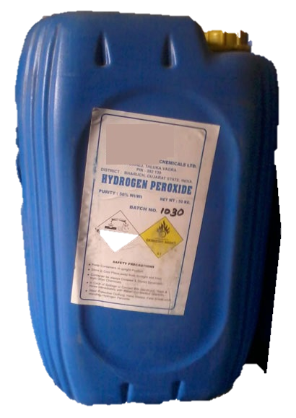
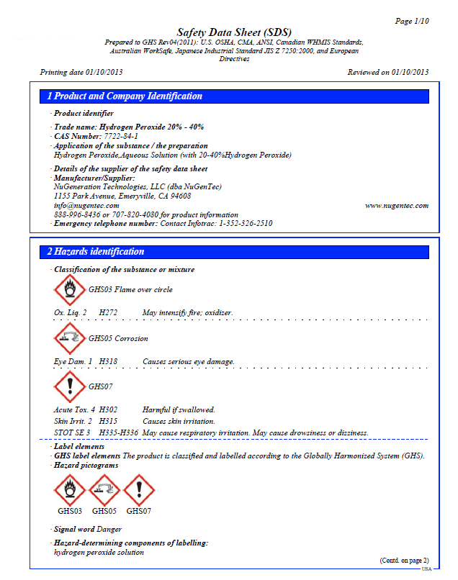
How do you get information about hazardous chemicals?
You can get information two ways:
from the product label,
from the product Safety Data Sheet or SDS.
Notes:
Slide 66. “Until the new design requirements took place, labels were sketchy and didn’t have all the information about the hazards of chemicals in a product. Safety Data Sheets or SDSs now provide much more, detailed information, although some of it be not easy to understand.”

Slide 19
What do these 9 pictograms mean?
Extremely Toxic
Toxic
Health Hazard
Corrosive
Explosive/Reactive
Flammable
Gas Under Pressure
Oxidizer
Aquatic Toxicity
Notes:
Slide 76. “We have been learning several pictograms –or symbols- that must be used in labels and safety data sheets. All labels will have at least one of these 9 pictograms on the label, depending on the type of hazard or hazards the product has. Let’s review the meaning of each of the 9 pictograms.”

Slide 20
These are the 3 pictograms used for warning of Health Hazards
These first 3 pictograms cover health hazards of chemicals that can harm you if they get inside your body.
Notes:
Slide 77. “Chemicals pose a health hazard when cause acute toxicity (within 24 hours); skin irritation; serious eye damage or irritation; respiratory or skin sensitization; causes mutation; cancer; birth defects; affects specific organs or risk of aspiration.”

Slide 21
The four pictograms on the label are telling you…
Fatal if swallowed.
Fatal if inhaled.
Remove person to fresh air.
Toxic in contact with the skin.
Immediately call a poison center/doctor.
Wash thoroughly after handling.
Etc.
This is a flammable liquid and vapor;
Keep away from heat/sparks/ open flames/hot surfaces. – No smoking;
Store in a well-ventilated place. Keep cool;
Etc.
Corr
May cause cancer.
Causes damage to organs.
Obtain special instructions before use.
If exposed or concerned: Get medical advice or attention.
Store locked up
Etc.
DANGER!
Causes severe skin burns and eye damage;
Do not breath dusts or mists;
If swallowed: Rinse mouth. DO NOT induce vomiting;
Store locked up
Etc.
Notes:
Slide 72. [this slide is animated, so you can show the pictogram and get input from the workers on what warning message are they getting out of it.]

Slide 22
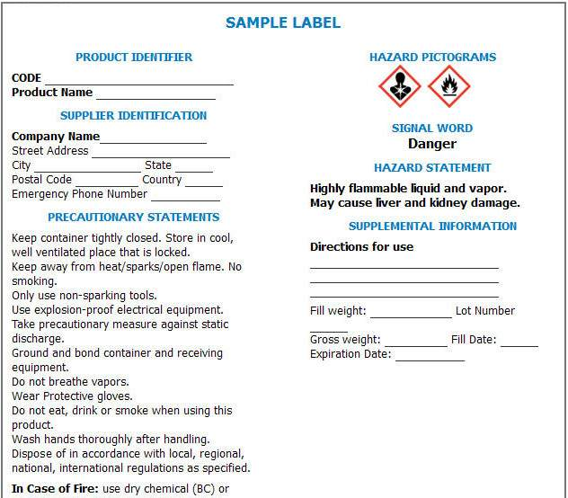
What’s on a Chemical Label?
© BLR®—Business & Legal Resources 1206
Notes:
Chemical labels will be on every container holding hazardous chemicals in your facility. A “container” is any bag, barrel, bottle, box, can, cylinder, drum, reaction vessel, storage tank, or anything similar. All containers of hazardous chemicals must be labeled. If the labels are removed or damaged, they must be immediately marked with the required information. You will find the following information elements on chemical labels:
Product identifier
Supplier identification
Signal word
Pictogram
Hazard statement
Precautionary statement
Supplemental information
Let’s take a look at each element.

Slide 23
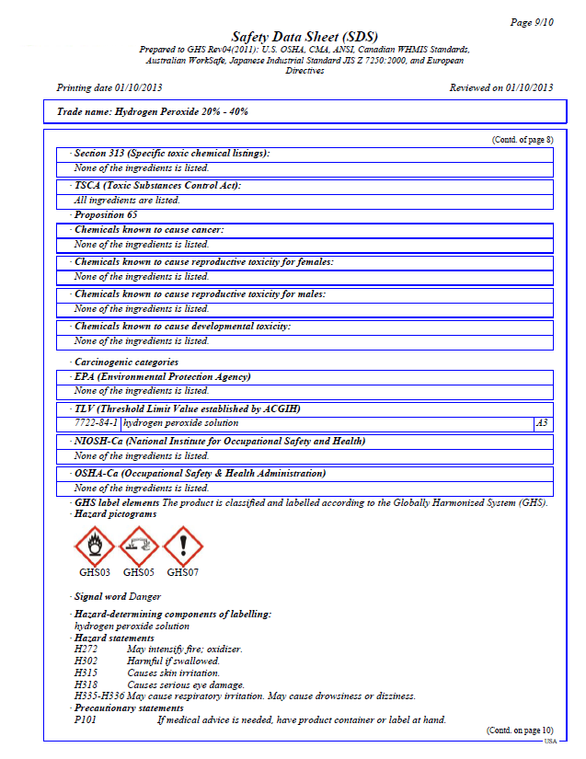
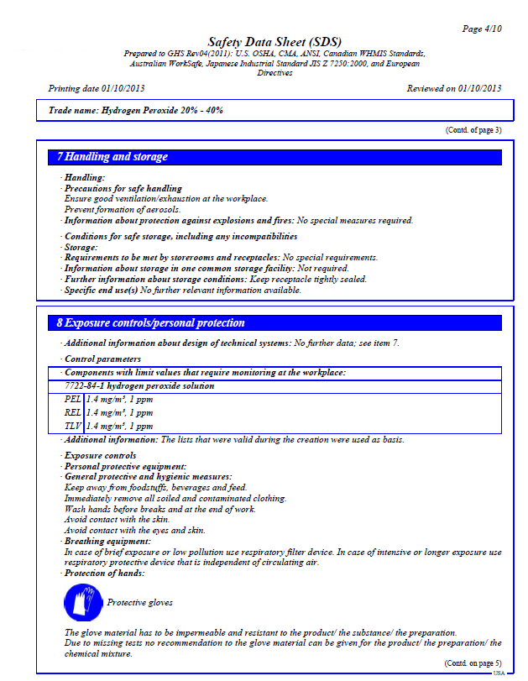
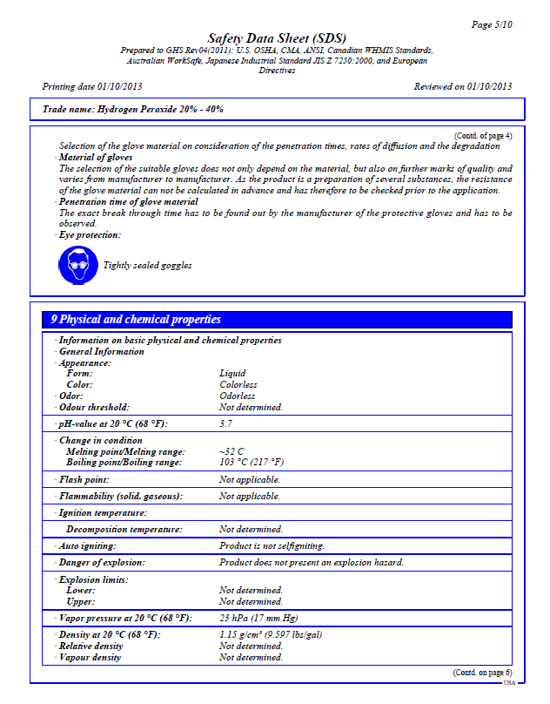
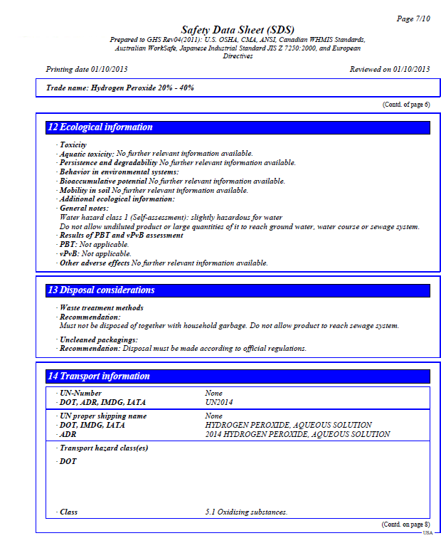
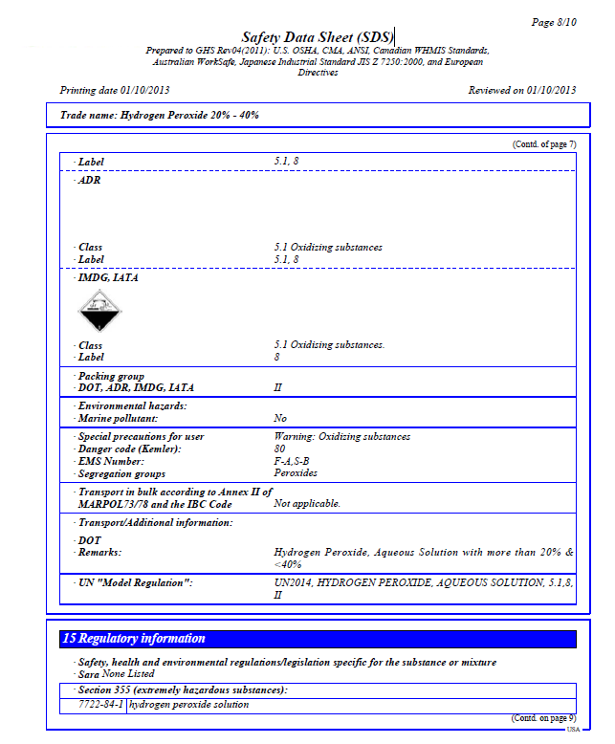
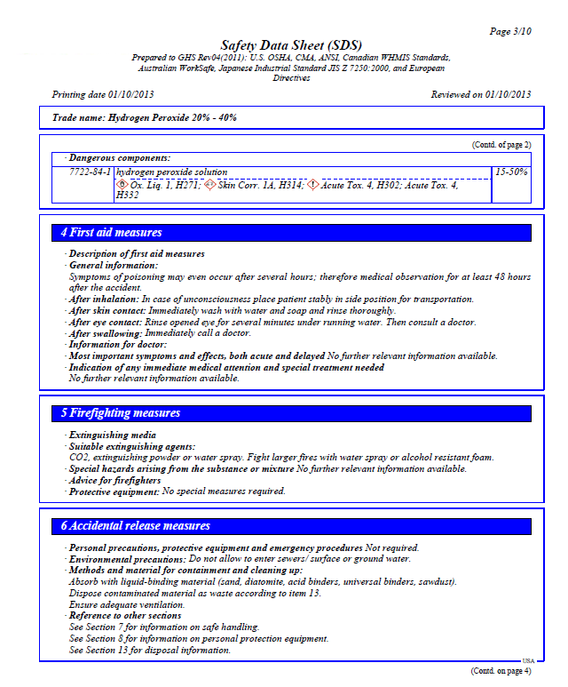
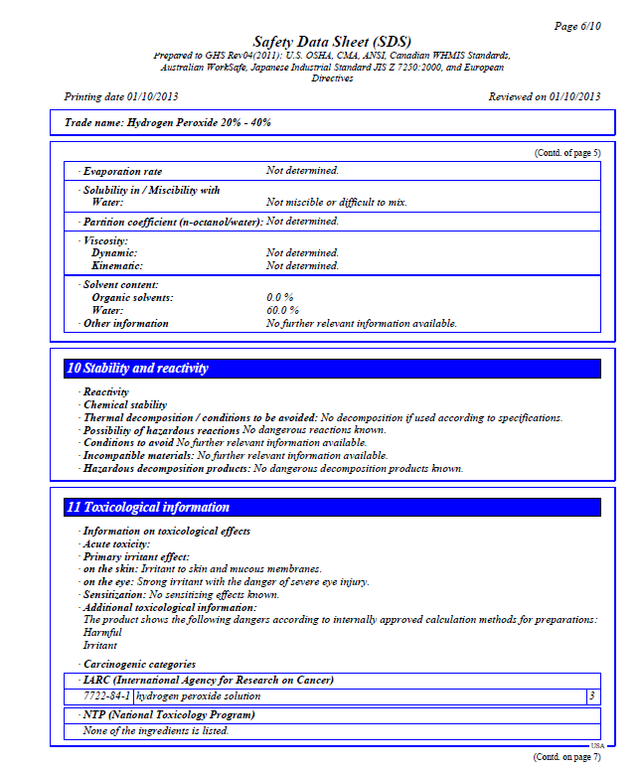
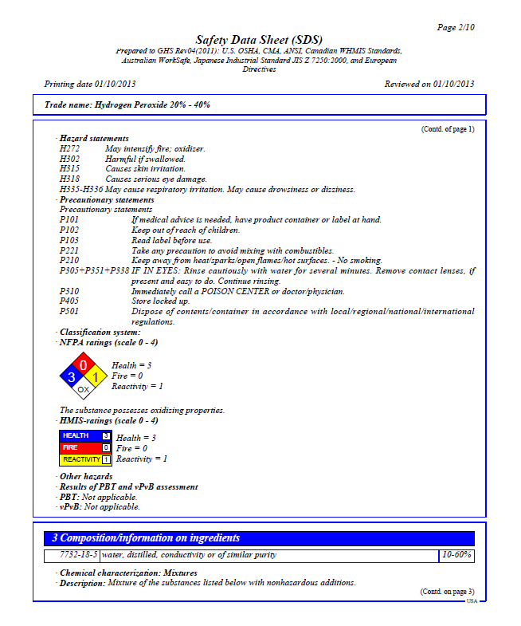
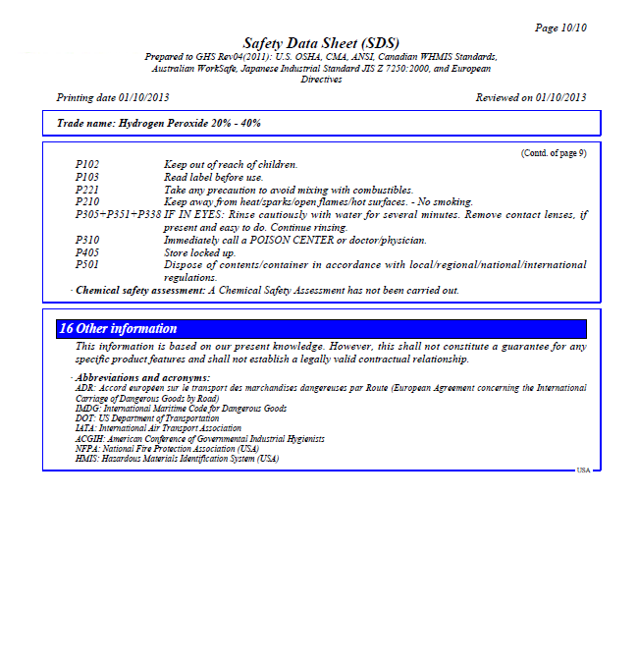
Let’s tour the 16 sections of the SDS
Section 1: Identification
Section 2: Hazard(s) identification
Section 3: Composition/information on ingredients
Section 4: First-aid measures
Section 5: Firefighting measures
Section 6: Accidental release measures
Section 7: Handling and storage
Section 8: Exposure controls/ personal protection
Section 9: Physical and chemical properties
Section 10: Stability and reactivity
Section 11: Toxicological information
Section 12: Ecological information
Section 13: Disposal considerations
Section 14: Transport information
Section 15: Regulatory information
Section 15: Regulatory information
Section 16: Other information, including date of preparation or last revision.
Notes:
Slide 69. [This slide will take several minutes of your training.] “Safety Data Sheets are required to provide information of the chemical you are working with. The information is organized in 16 sections. We’ll review one by one in this example SDS for hydrogen peroxide 20% - 40%.”
[PREFERRED OPTION: use a hardcopy of an SDS that actually pertains to your worksite operations]
[While showing each section, you may read a couple lines of data; discuss it among the participants to see their understanding. Pay more attention to sections 4 through 8 (in orange on the slide) where directions to prevent an incident are presented.]
“The chemical hazard communication standard requires that manufacturers of hazardous chemicals develop Safety Data Sheets for their products and give copies to all businesses that buy their products. Safety Data sheets will also have pictograms that are the same as those on the product label. ”

