Slide 1
BRANDT US DOT Hazmat Training

Slide 2
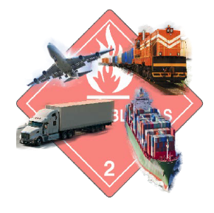
DOT Hazmat Overview
US DOT Required Training
General Awareness
Function Specific
Safety Measures
Security Awareness
In-depth Security
Please watch the Video attached on the next slide
In it you will be given an overview of the DOT regulations General Awareness, Safety Measures and Security Awareness. After you have viewed the video, you will need to return to this presentation and complete the additional topics required by the regulations.

Slide 3
HAZMAT Video – click on the link to play the training video
https://www.youtube.com/watch?v=oqgcOzjIYTI

Slide 4
Function Specific for Retail Ag facilities.
In this section we will review the following:
How to identify packages that are regulated as DOT Hazmat
Placarding & Labels
Shipping Papers
Load Securement
Farmer Exemptions

Slide 5
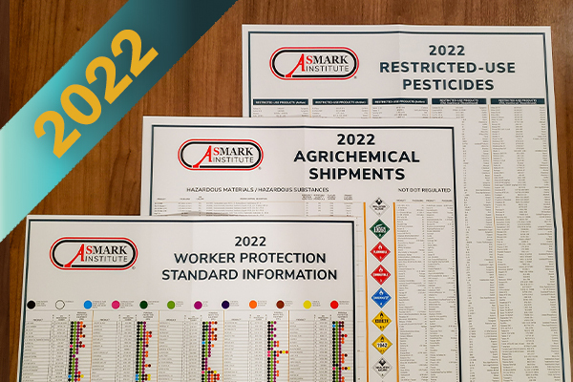
How to identify packages that are regulated as DOT Hazmat
You, as the shipper, are responsible to determine if the materials you are shipping meet the definition of a Hazardous Material.
Question: How do you determine if the material in a package, keg, tote or other container is regulated under the standard?
I can look it up on the wall chart in the office.
Find the DOT Hazardous Materials Table on the internet then find the listing by active ingredient.
The plant manager and/or admin can find what products are Hazmat, they will print off the paperwork.
I can check the SDS, it should list it some where.
I could look at the container, it’s marked with placards or labels to designate the product as Hazmat.
I can call EHS

Slide 6
How to identify packages that are regulated as DOT Hazmat
The SDS is one way to determine if the manufacture has identified the materials being shipped as Hazmat.
But where in the SDS do you find the shipping information?
Section 14

Slide 7
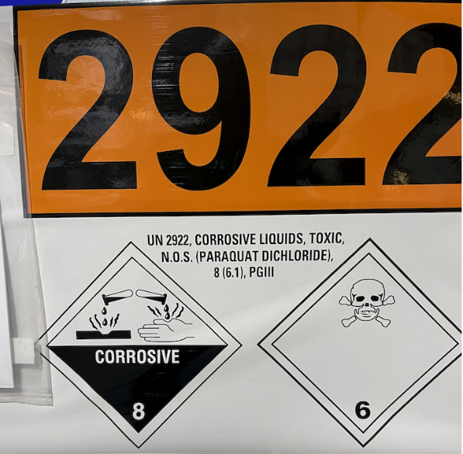
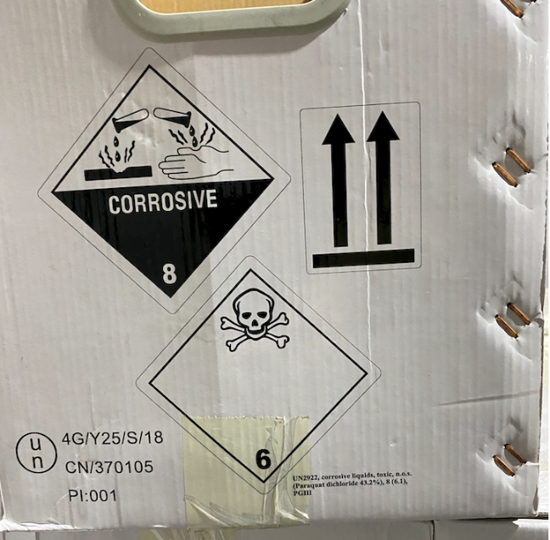
How to identify packages that are regulated as DOT Hazmat
Check the container:
The container will have the shipping information

Slide 8
Container Markings
Examples of proper markings

Slide 9
Container Markings
Would you ship either of these two containers?
Damaged placard.
Label says Junk, does it contain hazmat?
These containers cannot be shipped until properly marked

Slide 10
Package Size Matters
Watch the package sizes; many of the Class 9 Materials are regulated when they are in Bulk (totes more that 119 gallons) but not when packaged in smaller containers.
Examples include most of the 2,4-D pesticides.

Slide 11
Examples of products & package sizes

Slide 12
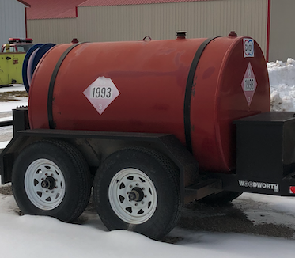
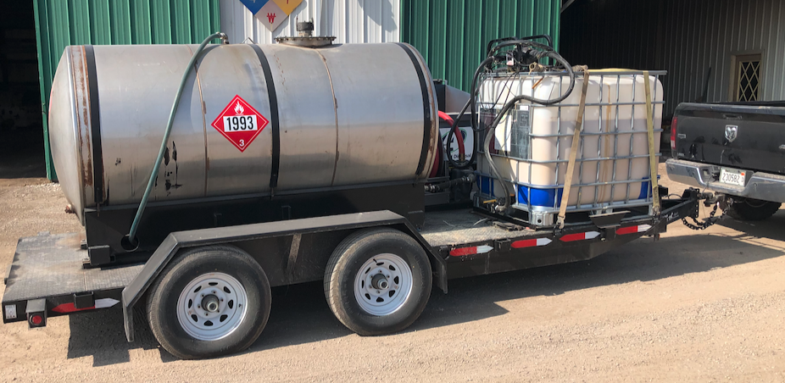
Packages
DOT uses the word “Package” to describe any container that is designed to transport materials. Don’t forget to look at All Packages before you transport “move the product on the road”.

Slide 13
Placarding & Labels
When do we need to placard a vehicle transporting HM? The two primary triggers are:
Placards are required when we are shipping/transporting 1001#’s or more of total Hazmat not the total load.
Transporting bulk containers (fuel tanks, mini-bulks etc.) with HM labels or placards, full or empty.
We do not need to placard Mixed/ Blended loads of pesticides that are in route to or from the fields.
There are a few exceptions:
if you are mixing for aerial applications,
at very high concentrations,
from containers with HM markings.
These materials would most often have the Reportable Quantities (RQ) as part of their shipping description.
(see Appendix A of the HM Table)
FARMERS HAVE AN EXEMPTION; THEY ARE NOT REQURED TO DISPLAY PLACARDS

Slide 14
Shipping Papers
OK, we’ve determined that the material is DOT Hazmat Regulated. Now what?
Do you need shipping papers if you are only going plant to plant?
Do farmers need shipping papers, don’t they have an exemption?
Do you need shipping papers for empty totes, from the farm back to the plant?
The chemical I’m shipping is not on the list! What to do?
Do Ammonia nurse tanks require shipping papers, they are placarded? No, there is an exemption for NH3 nurse tanks.

Slide 15
Do you need shipping papers if you are only going plant to plant?
Answer: Yes
Anytime HM is in transit shipping papers must accompany the shipment. Let's look at an example, we are going to transfer 4 totes of Brash from Lincoln to New Berlin.

Slide 16
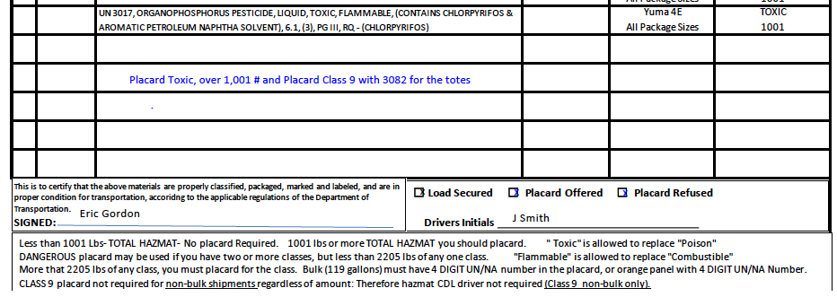
Do farmers need shipping papers? Don’t they have an exemption?
Answer: You are required to offer farmers both the shipping paper and placards. He is the one with the exemption. You must keep your copy of the shipping paper for two years.
I listed placards offered, and that he refused I also marked the load was secured.

Slide 17
Do you need shipping papers for empty totes, from the farm back to the plant?
Answer: Yes, empty HM totes are required to have shipping papers same as full. You can mark the weight as “Residue Last Contained”

Slide 18
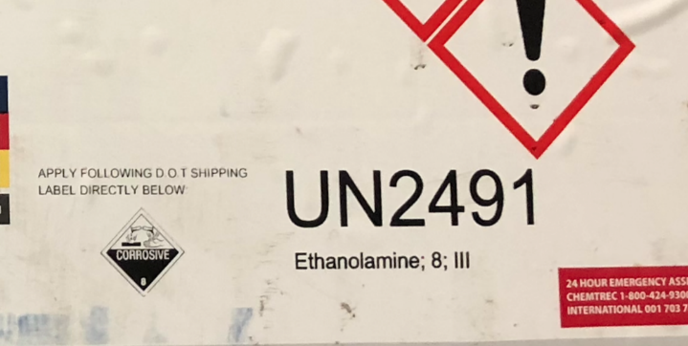
The chemical I’m shipping is not on the list! What to do?
We have listed most of the products you ship, however, if you don’t find the item, you can add to the bottom. The tote has all the information you need.
Copy the shipping information
from the container onto the
shipping form, the last two columns
are not required.

Slide 19
Placarding & Shipping Papers for fuel tanks
If you are tendering equipment in the field
and transfer fuel, either in totes or a tank wagon
you are required to have a shipping paper for the
Diesel. The driver of the pickup would need a
Class A CDL , Hazmat and Tanker.

Slide 20
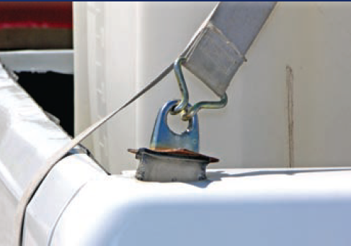
Load Securement
Is this tote secure?
Can you identify both issues?
1- Totes require two straps.
2- Look at the attachment point, it
is the weakest link!
NOT SECURE

Slide 21
Load Securement
Who is responsible? Shipper or driver?
As the shipper we are responsible to prepare the load for shipment, both photos show loads that
are not in compliance

Slide 22
In-depth Security
Brandt’s retail facilities are required to have a written DOT Security Plan.
Our primary concern is the theft of Nh3 and the damage it could do if released in our communities.
Your manager has a copy of the written program, if he/she determines that you have a need to know, you will be briefed on the plan. Questions should be directed to your manager or Cortney

